Slide 1

Movie Recommendations
-Chaitanya Kunapareddi

Slide 2
Agenda
To build a model using the dataset provided to generate movie-recommendations for users
Understand what the dataset contains and how to put into use
Generate visual charts to derive insights
Use mathematical and machine learning approaches to suggest recommendations

Slide 3
Business Goal
Increase users for an OTT platform
Gain user satisfaction by suggesting best movies of their choice

Slide 4

Data Exploration
Movie
Movie ID
Title
Rating
User ID
Movie ID
Consolidated
Movie ID
Count of Reviews
Genre
Rating
Time Stamp
Average Rating
One - Hot Encoded Genres
27,279 X 25
100000 X 3
27279 X 3

Slide 5
Data Exploration
MovieId | Title | Genre
5 | Father of the Bride Part II (1995) | Comedy
9 | Sudden Death (1995) | Action
UserId | MovieId | Rating | Timestamp
1 | 2 | 3.5 | 4/2/2005 11:53:00 PM
604 | 831 | 4.5 | 5/16/2007 2:58:00 AM

Slide 6
Data Preprocessing
Look up user for total user count per movie
Average rating per movie
One hot encoded genres
Sub setting movies with no genre, no rating, no review

Slide 7

Data Insights

Slide 8
Data Insights

Slide 9
Data Insights

Slide 10
Data Insights

Slide 11

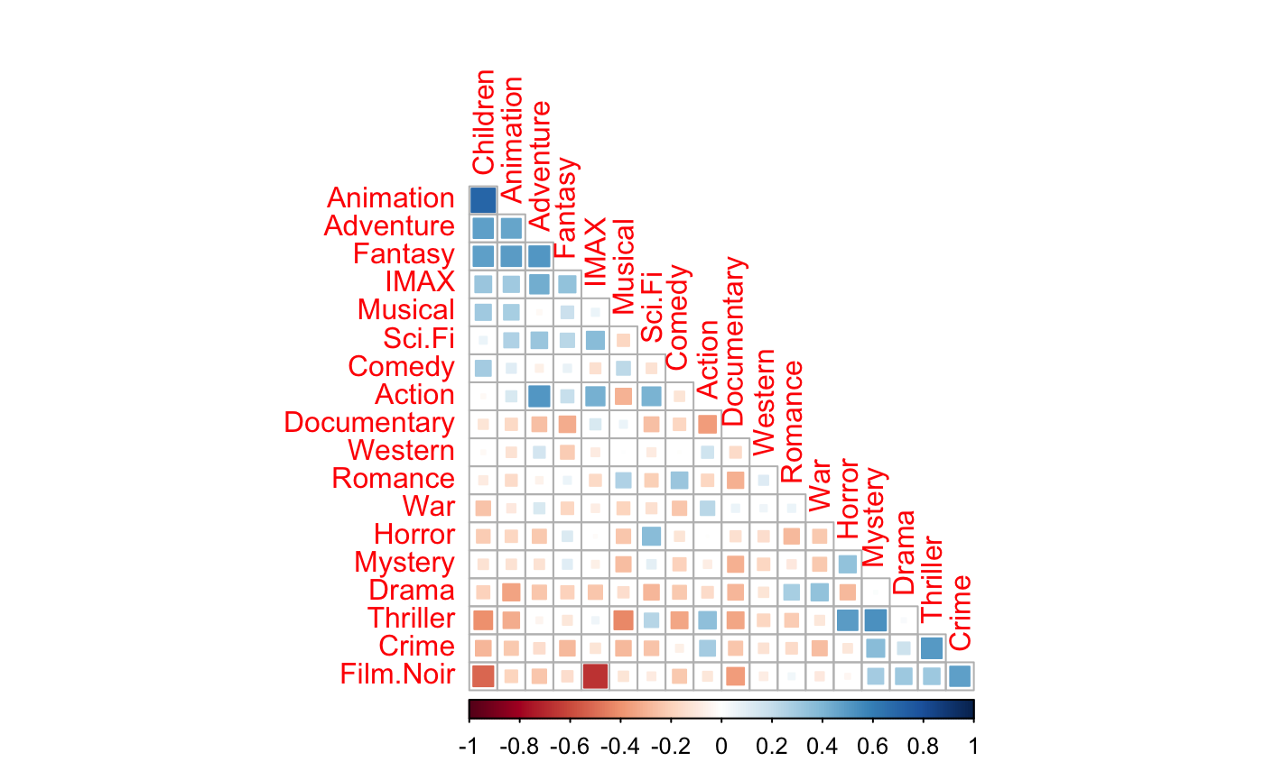
Data Insights
Genre Correlation

Slide 12








Case 1: General Recommendation
= 3.28
= 30

Slide 13




Case 1: General Recommendation
Weighted Rating

Slide 14
Case 1: General Recommendation
Title | Count of Reviews | Rating | Score
Shawshank Redemption, The (1994) | 305 | 4.41 | 4.308967
Godfather, The (1972) | 197 | 4.40 | 4.252220
Godfather: Part II, The (1974) | 137 | 4.42 | 4.215533
Usual Suspects, The (1995) | 224 | 4.34 | 4.215015
One Flew Over the Cuckoo's Nest (1975) | 148 | 4.36 | 4.178281

Slide 15


Case 2: Cosine Similarity
Model
TITLE
TITLES
Transformed Genres
Linear Kernal
Cosine sim
Genre Similarity

Slide 16
Case 2: Cosine Similarity
Given Movie | Recommended Movie
Toy Story (1995) | Antz (1998)
 | Toy Story 2 (1999)
 | Adventures of Rocky and Bullwinkle, The (2000)
 | Emperor's New Groove, The (2000)
 | Monsters, Inc. (2001)
 | Duck Tales: The Movie - Treasure of the Lost Lamp (1990)
 | Wild, The (2006)
 | Shrek the Third (2007)
 | Tale of Despereaux, The (2008)
 | Asterix and the Vikings (Asterix et les Vikings) (2006)

Slide 17









Case 3: KNN
Forming Clusters with likelihood
Movies, users and rating based clusters
Model generates names of movies that have been watched by similar users with similar ratings

Slide 18
Case 3: KNN
Given Movie | Recommended Movie
Harry Potter and the Chamber of Secrets (2002) | Dad (1989)
 | Privates on Parade (1982)
 | Thomas and the Magic Railroad (2000)
 | Solaris (2002)
 | Night to Remember, A (1958)
 | Lord of the Rings: The Return of the King, The (2003)
 | Evil Dead II (Dead by Dawn) (1987)
 | Breaking In (1989)
 | Grey Fox, The (1982)
 | Official Story, The (La historia oficial) (1985)

Slide 19
Conclusion
This OTT has more average rated (3-4) movies than good (4-5) we can rise up the rating by use of our general suggestive model which are globally loved.
There are no specific reasons as why users don’t like or dislike the movies, this could help understanding them better and suggest more relatable movies
The general model is only a baseline model and can be used for promotions
The cosine similarity model is great in suggesting movies that belong to similar genres, alas it may not be good always as the rating is not evaluated
The KNN model has decent performance but is a good model that suggests movies based on how many users have watched it and how they have rated it

Slide 20
Ethics & References
The sole purpose of this project is to create a recommender from the data shared by the organization for test purposes.
The data is also globally hosted.
I would also like to credit, coursework professors, towards data science and analytics vidya for helping in the process of learning.

Slide 21

Thank you

